Slide 1


Customer Segmetetion
Presented By : Rajesh Devanal

Slide 2
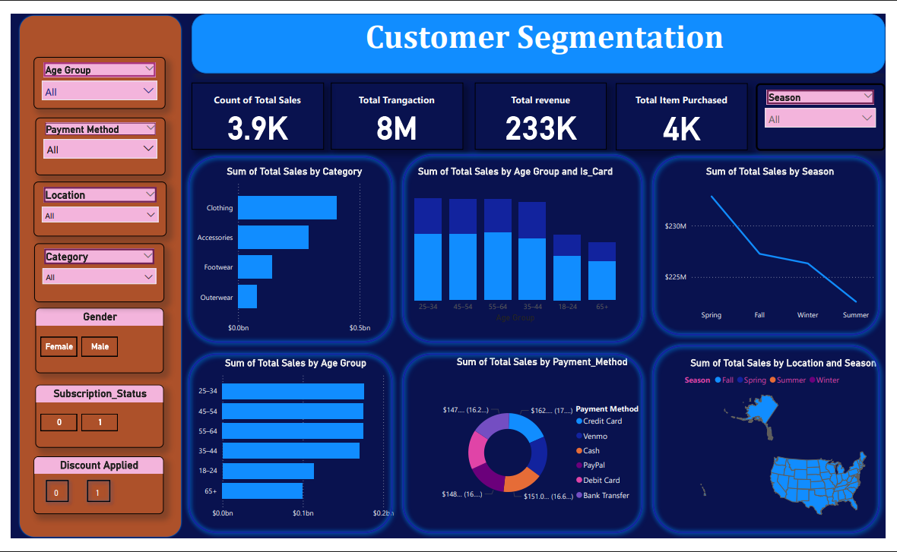
Dashboard

Slide 3
Introduction
Identifies distinct customer groups based on purchasing patterns
Helps businesses design targeted and personalized marketing strategies
Improves decision-making for pricing, promotions, and inventory management
Enhances customer satisfaction and retention through relevant offers

Slide 4
Dataset Overview
Customer age and gender details
Product category and items purchased
Purchase amount and spending patterns
Preferred payment methods (card, cash, digital)
Seasonal shopping behavior (Spring, Summer, etc.)
Geographic location of purchases
Discount and promotional code usage
Frequency and consistency of purchases

Slide 5


Overall Business Performance
3.9K
Sales Records
233K
Total revenue
Clothing contributes the largest share of revenue
Accessories and Footwear show moderate performance
Outerwear sales are highly seasonal
Indicates strong customer demand in apparel category
Highlights opportunities for category-level optimization

Slide 6
Discount Strategy
Target low-performing product categories
Clear slow-moving and seasonal inventory
Attract price-sensitive customers
Increase purchase frequency during off-season
Boost customer engagement through promotions
Support short-term sales growth
Optimize stock management and reduce holding costs

Slide 7
Card Spending Analysis
Credit and debit cards are the most preferred payment methods
Working professionals show higher digital payment adoption
Seasonal offers increase card-based transactions
Urban customers prefer fast and cashless payments
Higher transaction value observed in card payments
Strong potential for bank and wallet partnerships

Slide 8
Customer Clustering
Unsupervised machine learning technique used
Customers grouped based on similar behavior
Features include spending, frequency, and discounts
Helps identify patterns not visible in raw data
Enables data-driven customer segmentation
Supports targeted marketing and personalization

Slide 9
Customer Segments
High-Value Loyal Customers
Frequent purchasers with high spending
Prefer card-based payments
Price-Sensitive Customers
Highly responsive to discounts and promo codes
Moderate purchase value
Occasional Buyers
Infrequent and irregular purchases
Lower overall spending

Slide 10
Targeted Marketing Strategies
Loyalty Programs
Reward frequent and high-value customers
Encourage repeat purchases
Discount Campaigns
Attract price-sensitive customers
Boost sales during off-peak periods
Re-Engagement Offers
Target inactive or occasional buyers
Encourage return purchases

Slide 11
Business Recommendations
Focused Discounts
Apply discounts only to low-performing categories
Reduce excess and slow-moving inventory
Increase sales efficiency and profitability
Card-Based Offers
Encourage digital and cashless payments
Target high card-usage age groups (25–44)
Improve transaction speed and customer convenience
Seasonal & Personalized Marketing
Align campaigns with high-demand seasons
Deliver offers based on customer segments

Slide 12
Conclusion
Enables personalized and targeted marketing strategies
Improves customer satisfaction and retention
Optimizes pricing, promotions, and inventory planning
Enhances marketing efficiency and ROI
Supports long-term strategic planning
Helps businesses gain competitive advantage

Slide 13
Thank You

